Slide 1
TaskFlow
A smart, dark-themed task manager for iOS
Built entirely in SwiftUI · No third-party dependencies · iOS 14+
Team Alpha
v2.0

Slide 2
App Overview
TaskFlow — persistent, local task management with a pure SwiftUI stack
What it is
A dark-themed mobile task manager that lets you create, organise, prioritise, and track tasks — all stored locally on-device.
4
5
Tech stack
Screens
Task Categories
SwiftUI · Core Data · @EnvironmentObject · iOS 14+ Zero third-party dependencies.
Screen flow
0
3
Launch Screen → Task List → Task Detail / Add Task Two-tab navigation: Tasks | Statistics
Team
Dependencies
Priority Levels
Team Alpha — v2 (persistence + full CRUD added over v1 prototype)

Slide 3
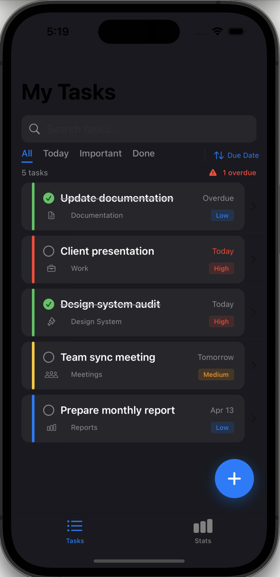
Task List
The home screen — every task at a glance with real-time filters and sorting
● Smart task cards with colour-coded status bar
Green = done · Red = overdue · Yellow = due soon · Blue = upcoming
● Priority badge on every card (High / Medium / Low)
● Category icon shows task type at a glance
● Strikethrough title for completed tasks
● Overdue counter shown in toolbar
● Swipe left to delete with confirmation
● Long-press context menu: Mark Complete or Delete
● FAB (blue +) opens Add Task sheet

Slide 4
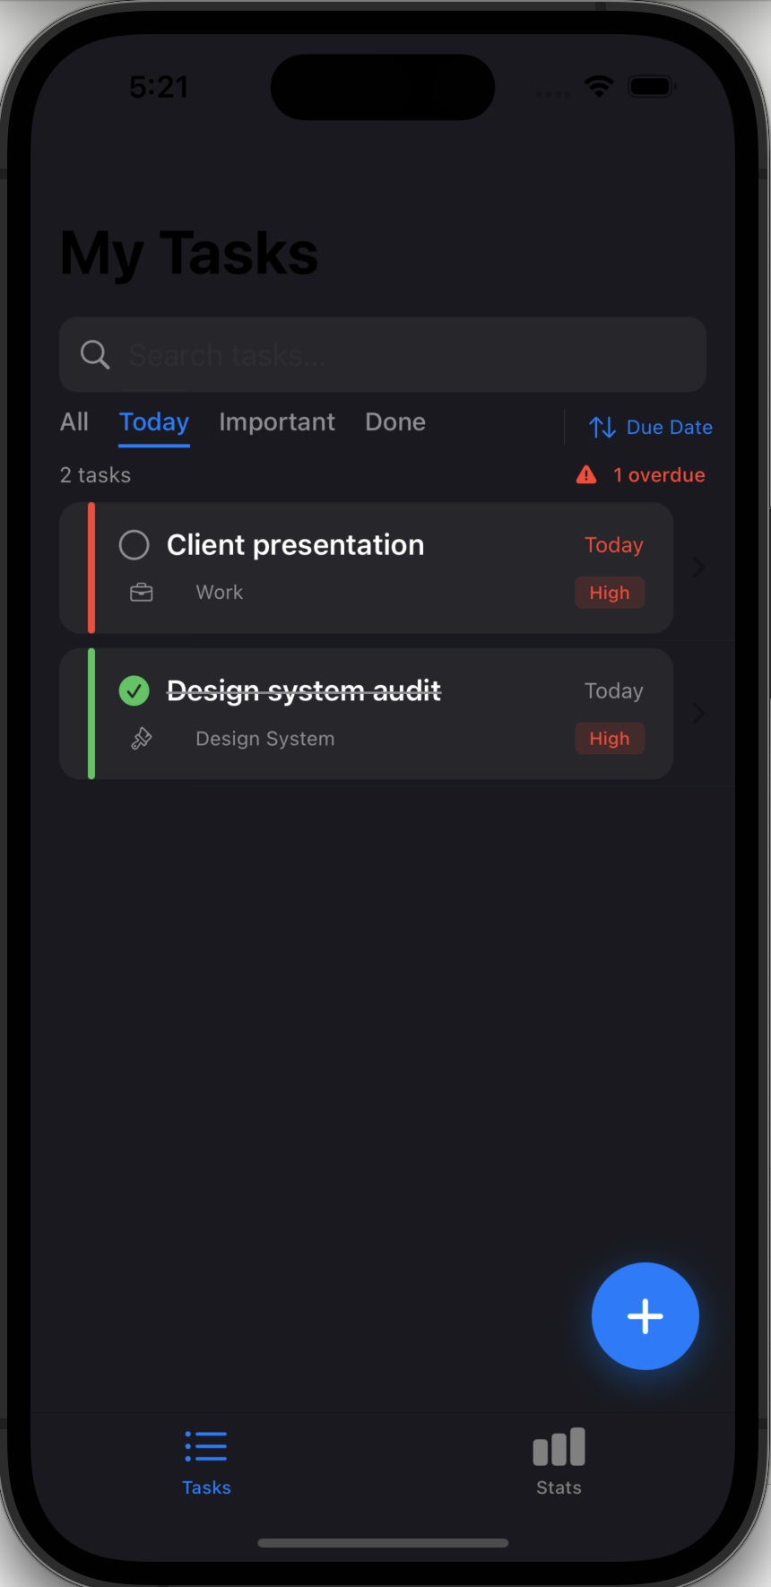
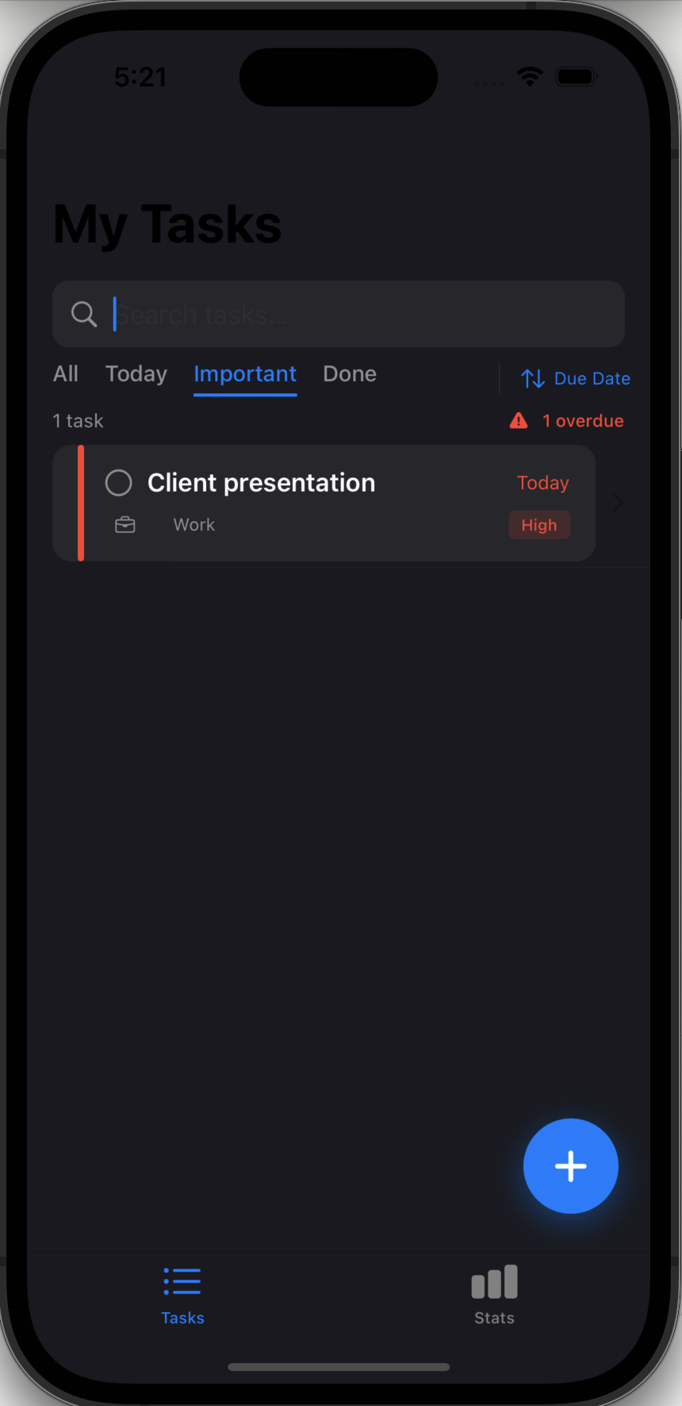
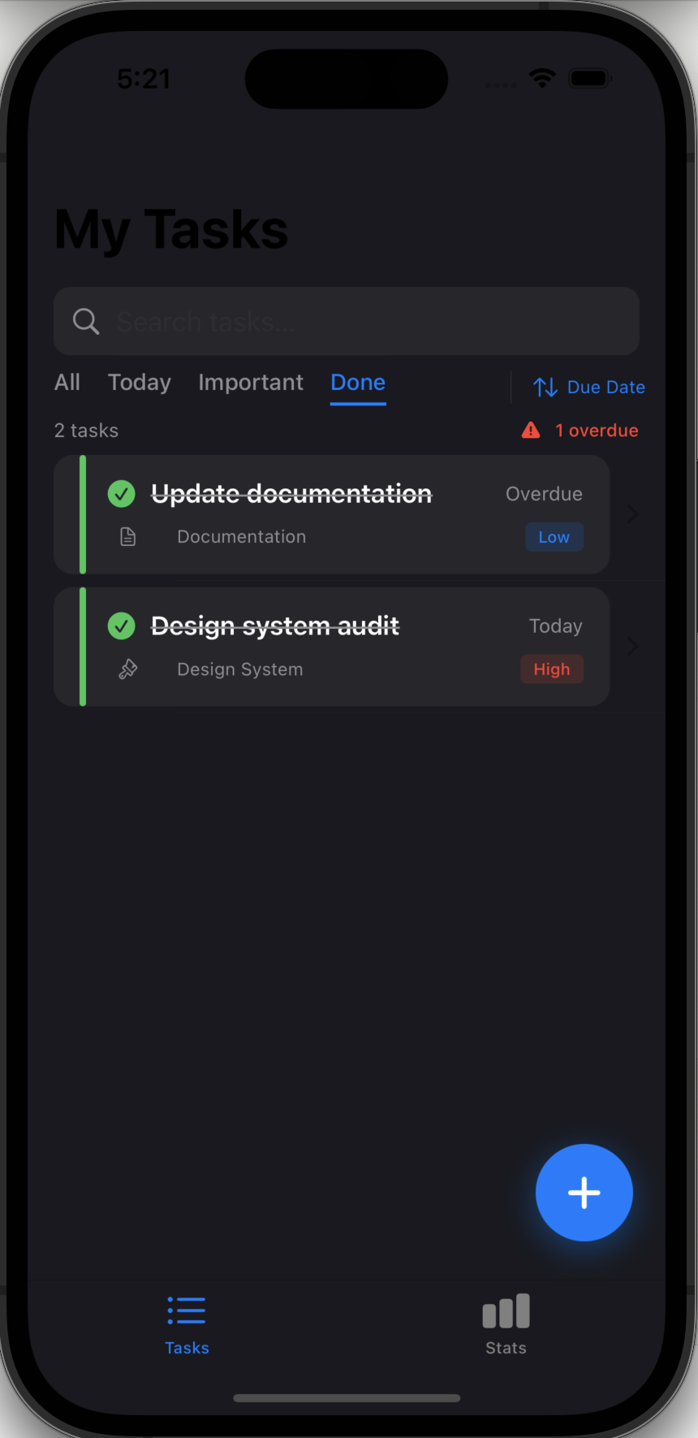
Filters & Sorting
Four tab filters + three sort options let you zero in on exactly what matters
Today
Important
Done
All
Today
Important
Done
Sort
Every task
Due today only
High priority + pending
Completed tasks
Due Date / Priority / Title

Slide 5
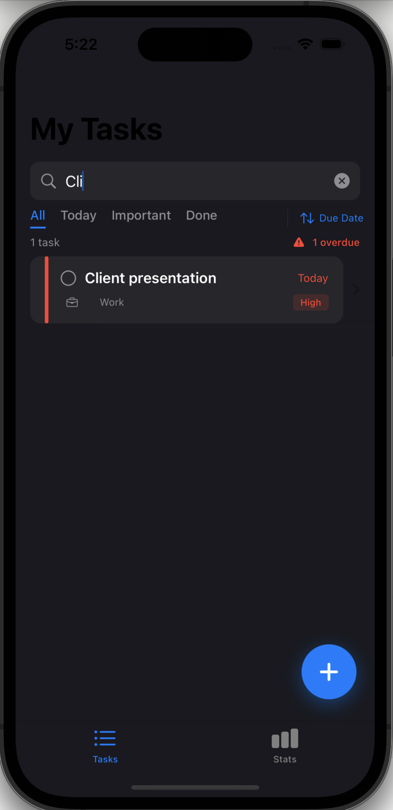
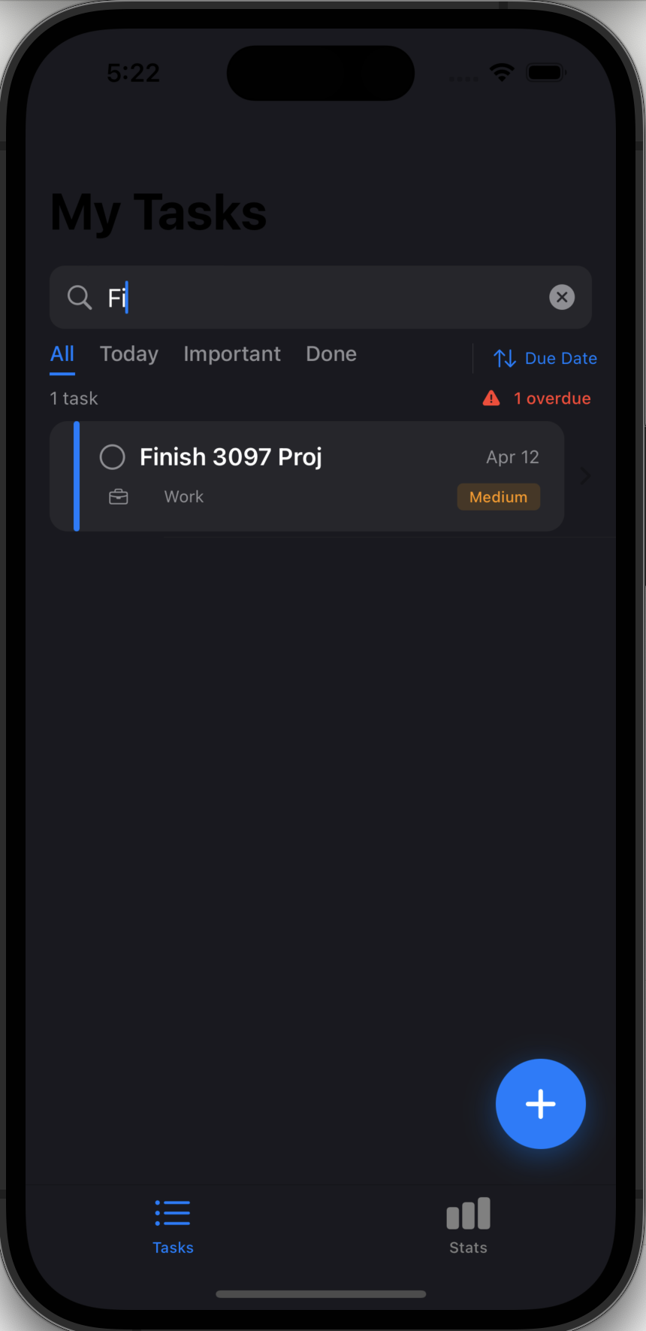
Live Search
Full-text search across title, description, and category — updates instantly as you type
● Search bar always visible at top of task list
● Matches title, description, and category
● Case-insensitive, instant results
● Clear (×) button appears when text is entered
● Empty results show friendly 'No results for…' state
● Search works alongside active filter tab

Slide 6
Add Task
A rich creation form with auto-computed status and custom category support
Task Name
Description
Required · free-text title
Optional · multi-line text editor
Category
Priority
Work / School / Personal / Design System / Meetings Documentation / Reports / Custom (user-defined)
Segmented control: High (red) · Medium (orange) · Low (blue)
Due Date & Time
Status Preview
Separate date and time pickers combined on save
Auto-computed: Overdue / Due Soon / Not Started
Save is disabled until a task name is entered · Saved tasks appear in the list immediately · Persisted across app restarts via Core Data

Slide 7
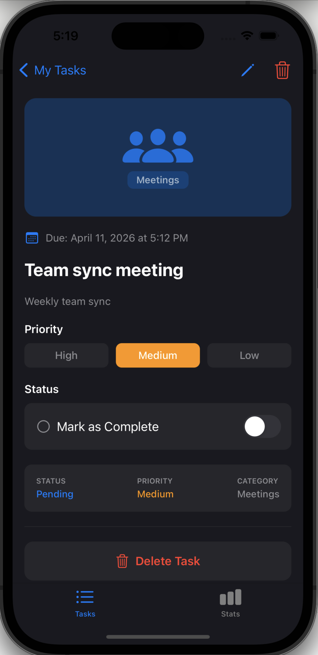
Task Detail & Edit
View every field, toggle completion, edit inline, or delete with one tap
Category Banner
· Adaptive icon + colour per category
· Meetings=blue · Work=orange · School=indigo · Personal=pink
· Design System=purple · Reports=green · Docs=teal
Priority Selector
· High / Medium / Low segmented picker
· Tappable in edit mode only — locked in view mode
Completion Toggle
· Toggle switch persists immediately to Core Data
· Title gains strikethrough · status shows 'Completed'
Inline Edit Mode
· Pencil icon → edit title, description, priority, category, due date
· Checkmark icon saves · Cancel reverts all changes
Delete with Confirm
· Trash button triggers confirmation alert
· On confirm: removes from store + navigates back

Slide 8
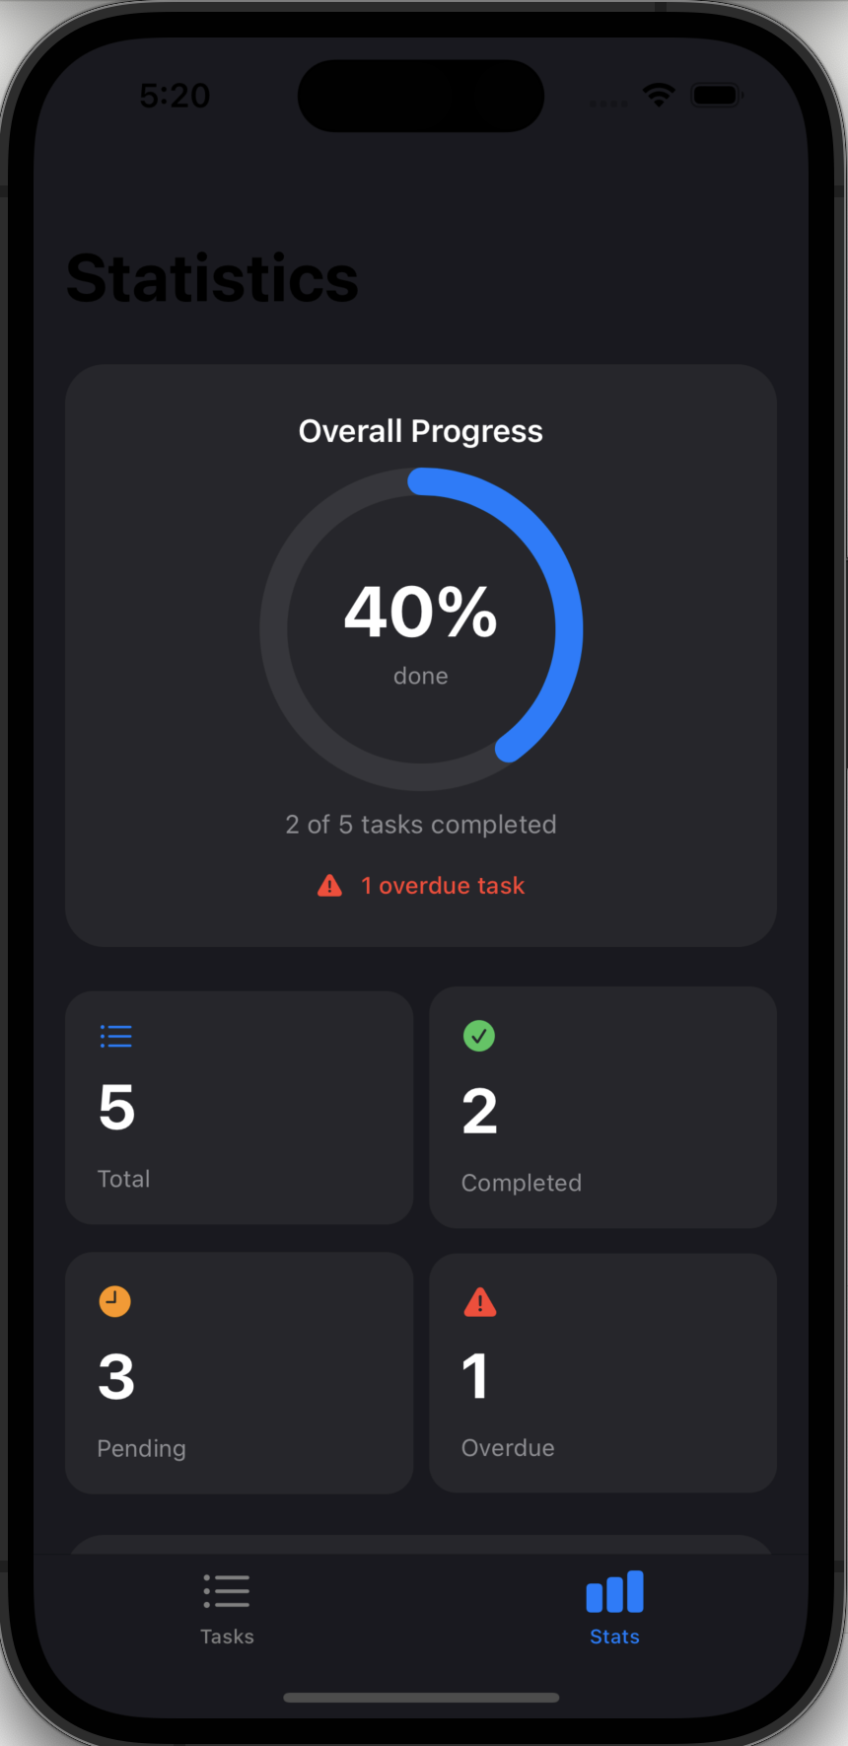
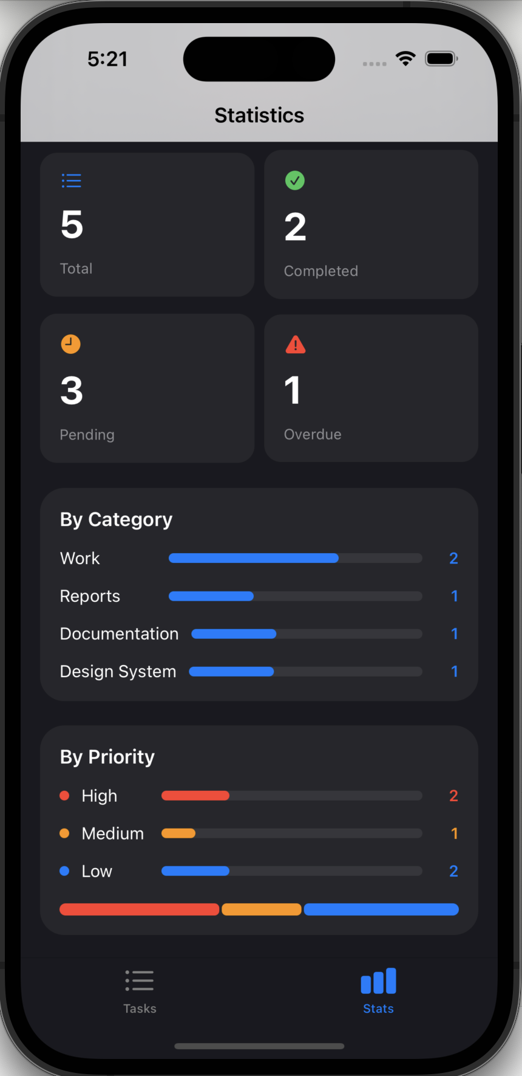
Statistics Dashboard
Live metrics derived from Core Data — the Stats tab updates as tasks change
Completion Ring
Animated arc from 0→completion % on appear and whenever tasks change.
Summary Grid
4 cards: Total · Completed · Pending · Overdue. Each with icon and accent colour.
By Category
Horizontal progress bars scaled to the busiest category. Auto-sorted by count.
By Priority
High / Medium / Low rows with bars + stacked overview bar at the bottom.
Overdue Alert
Red warning shown in ring card when 1+ tasks are overdue.

Slide 9
Architecture
Single source of truth via @EnvironmentObject — Core Data persistence layer
SmartTaskApp (entry point)
Initialises TaskStore and injects it as @EnvironmentObject
▼
LaunchScreenView
Fade-in splash → pushes to MainTabView after 1.5 s
▼
MainTabView
Tab bar host: Tasks tab (TaskListView) + Stats tab (StatsView)
▼
TaskListView / AddTaskView / TaskDetailView
All read/write TaskStore via @EnvironmentObject — no direct Core Data calls
▼
TaskStore (ObservableObject)
Owns NSPersistentContainer · publishes @Published var tasks · CRUD methods

Slide 10
Roadmap — Planned Features
Current build is ~30% complete · these features bring TaskFlow to a full v1 product
1
User Authentication
2
Cloud Sync & Backend
3
Push Notifications
Sign in with Apple · Firebase/Supabase · user-scoped tasks
Firestore/Supabase · real-time updates · offline cache
Local reminders at due date · offset options (15 min/1 h/1 day)
4
Search & Sort+
5
Subtasks & Checklists
6
Recurring Tasks
Multi-filter · full-text · sort by creation date / alpha
Nested checklist items · progress indicator on card
Daily / weekly / monthly · auto-next on completion
7
Custom Categories
8
Widgets & Shortcuts
9
Collaboration
Create, rename, colour-code, delete user categories
Home-screen widget · Siri Shortcuts integration
Task sharing · assignment · comment threads (stretch goal)

